Slide 1
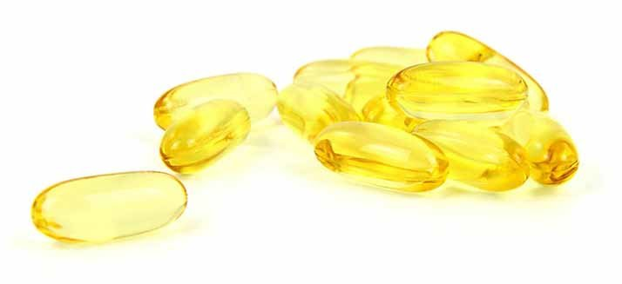
Market segmentation for muscle building vitamins in Europe
2020

Slide 2
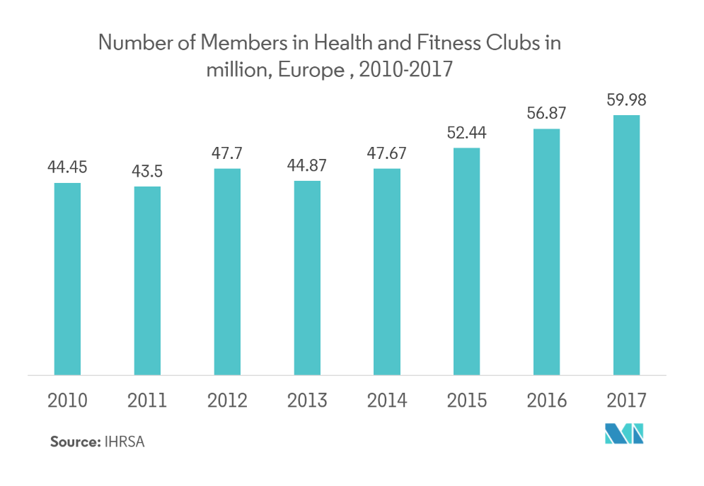
General overview
In the recent years, health clubs and fitness centers have witnessed consistent growth due to increase in health concerns and change in lifestyle in developing countries.

Slide 3
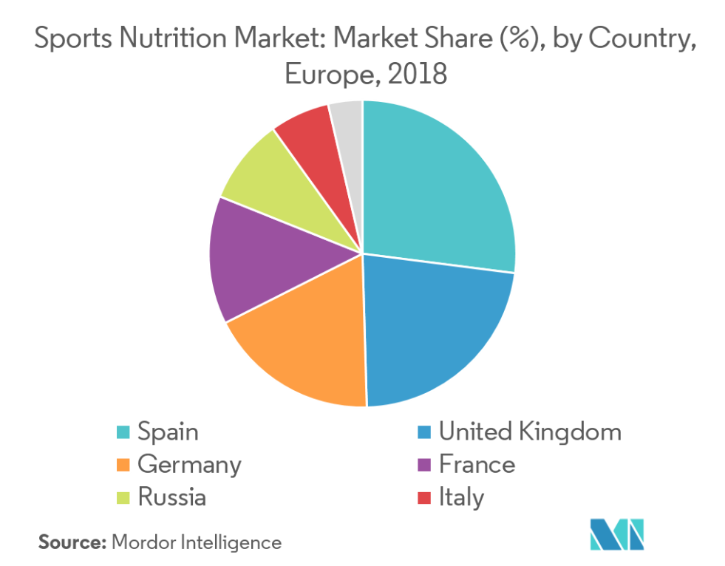
European trends
Rise in health awareness and need for adequate nutritional content in food have fostered the demand for these products. A surge in the number of middle-aged and geriatric population engaged in sports activities has further fueled the sports nutrition market growth.

Slide 4
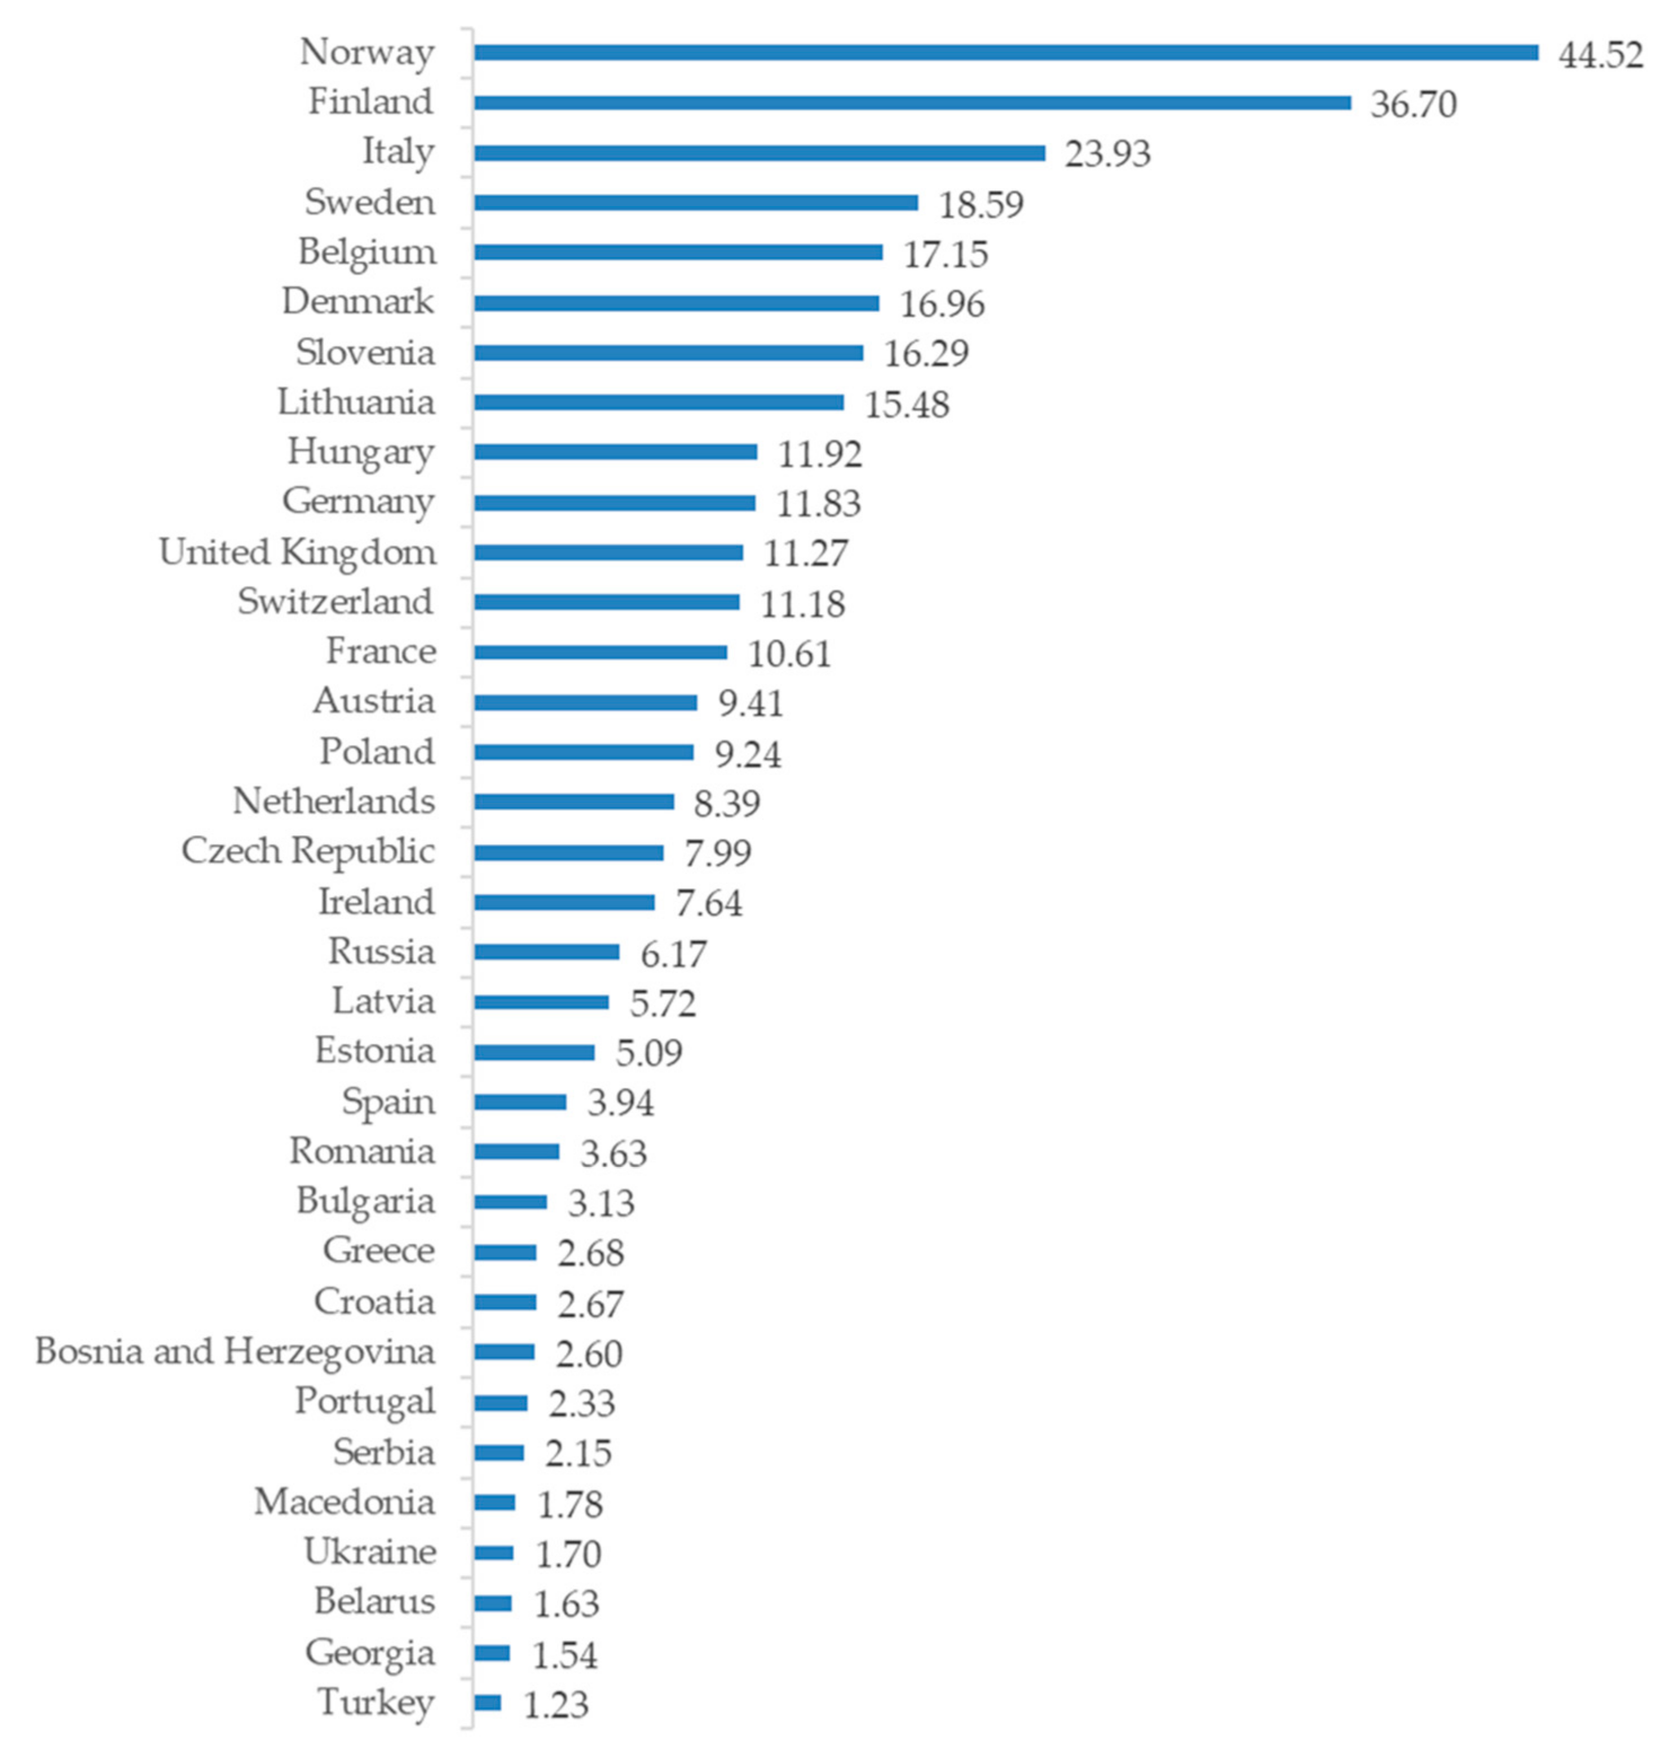
Value of the dietary supplements market per capita in Europe (€).
The data shows that the part of European market in the consumption of sportive supplements including muscles building vitamins is reletively small staying at 1.70 euro per capita which means a huge market development potential.

Slide 5
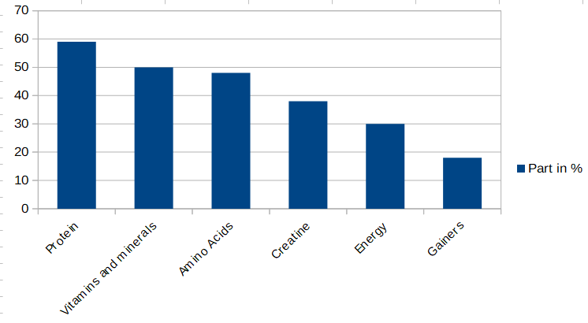
Consumption structure
About 26% of European are systematically involved in physical education and sports. In the USA this indicator reached 60%, in Germany – 40%.The highest demand among European is for protein, which takes 57 per cent of all consumed producats.

Slide 6
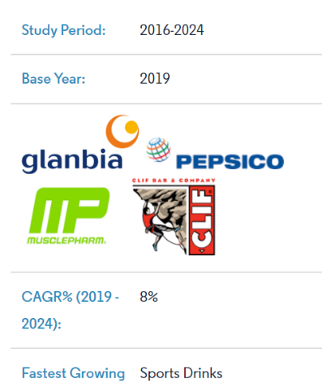
Products representation
The leading positions in the European market are held by Haleko GmbH & Co OHG, Optimum Nutrition Inc, Weider Global Nutrition LLC, Twinlab Corp, Prolab Nutrition Inc and Universal Nutrition IncBrand loyalty is a high-impact factor, with the quality of ingredients being a prime parameter.
Companies are focusing on quality, and this attribute plays a pivotal role in brand positioning. Some of the prominent players in the market are Glanbia PLC, PepsiCo Inc., Atlantic Multipower Germany GmbH (Atlantic Grupa DD), KONZEPT, Clif Bar, and MusclePharm Corp.

Slide 7
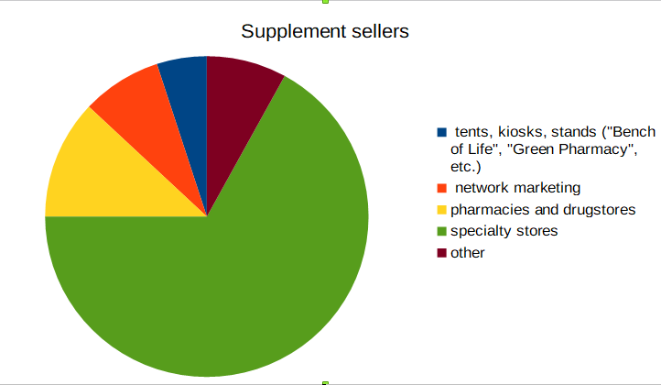
Sales structure of supplements of the sports nutrition group (in terms of value) (2019)
67.0% of all supplements are sold through specialty stores, including on-line stores

Slide 8
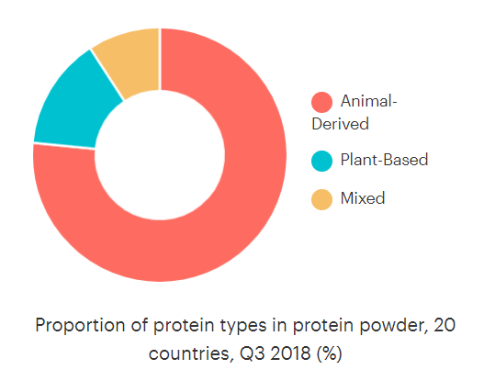
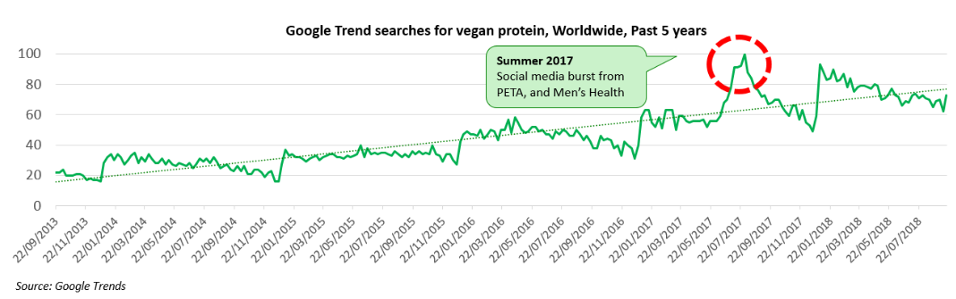
Plant-based formulas
Plant-based formulas representing 15% of products available across 20 countries are becoming increasingly popular, and this is driven by several interlinking trends:
Emergence of a plant-based diet as the new healthy eating ideal
The high protein trend
Meat reduction/flexitarianism
Personal health goals (cholesterol reduction, minimising cancer risk, etc.)
Veganism
Ethical concerns (particularly animal welfare)
Sustainability and other environmental concerns
Free-from trend (dairy proteins are common allergens)

Slide 9
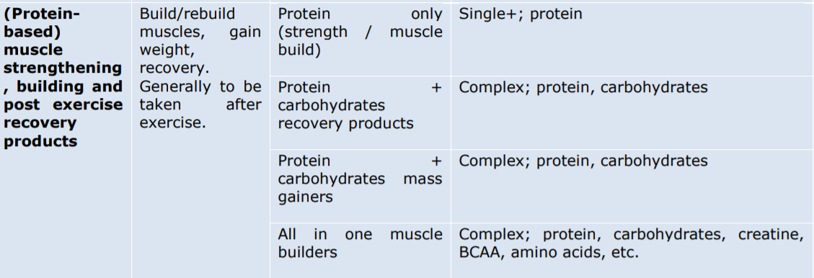
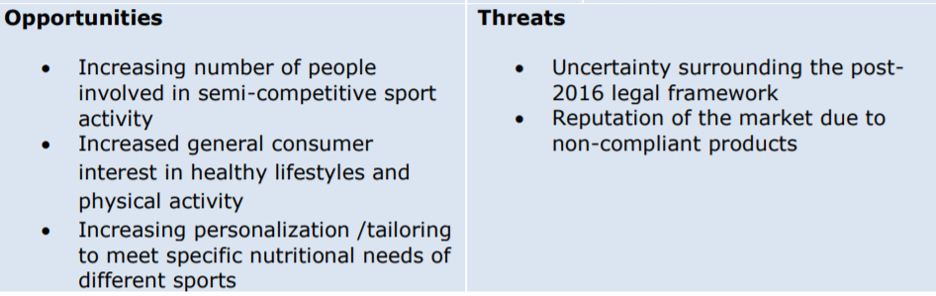
Targeted product (muscle building vitamins) classification and selling potential

Slide 10
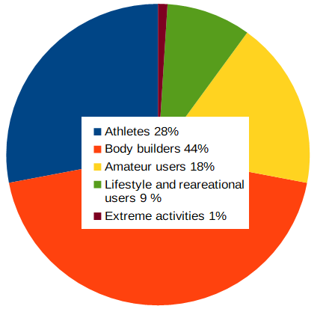
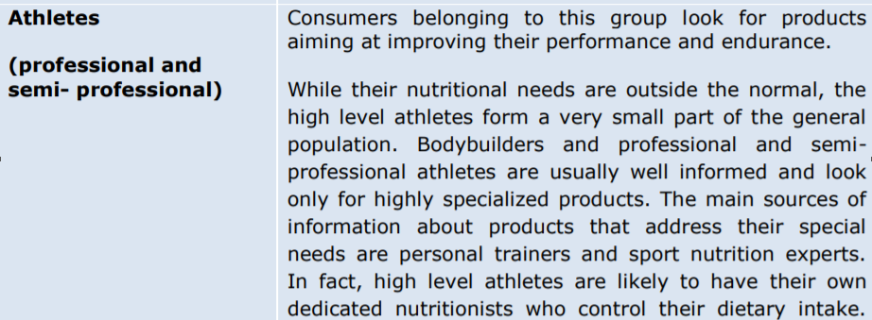
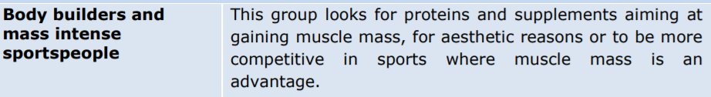
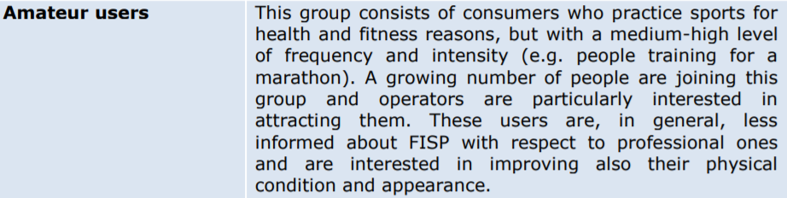

Market segmentation by end user
A small part of consumers may not be sportspeople nor lifestyle users but rather
people involved in extreme physical activities other than sport, for example the
military, emergency services or manual labour.

Slide 11
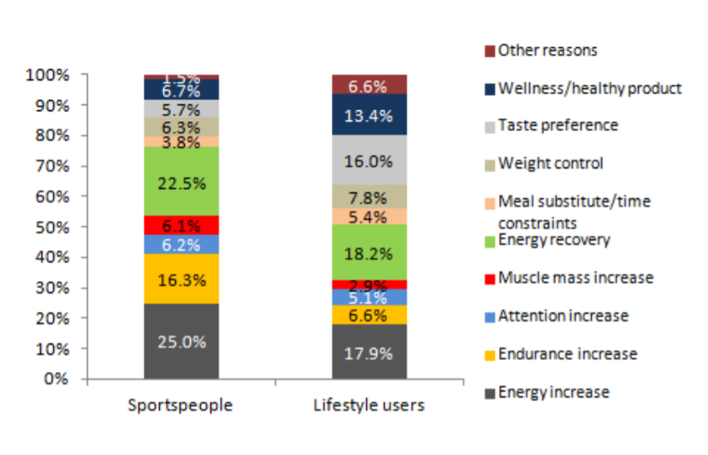
Reasons behind consumption
According to the consumer survey results, motivations behind the consumption of mucsle building supplements do not necessarily reflect the original “objectives” for which these products were intended. This is particularly true for lifestyle users. For instance, 14.6% of protein-based products are consumed by amateur users in relation to wellness and health.

Slide 12
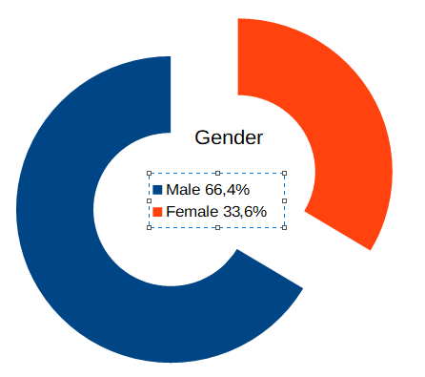
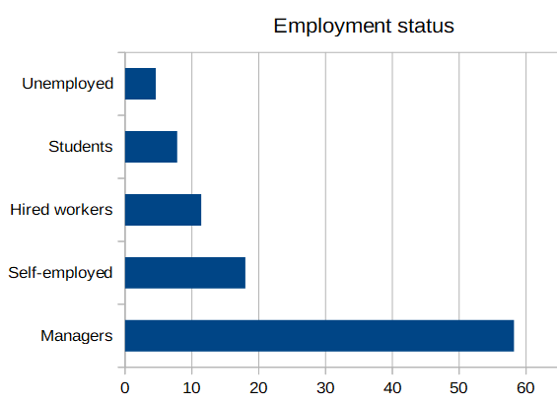
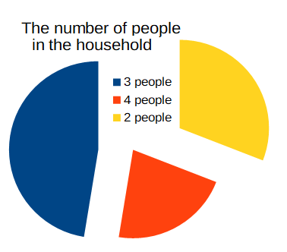
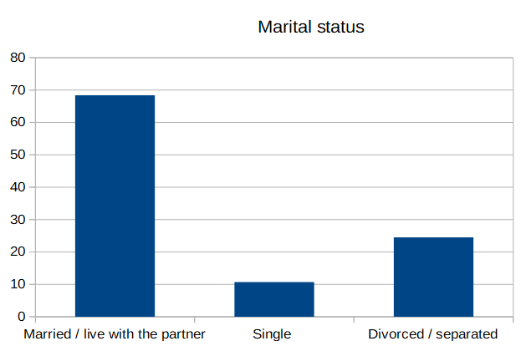
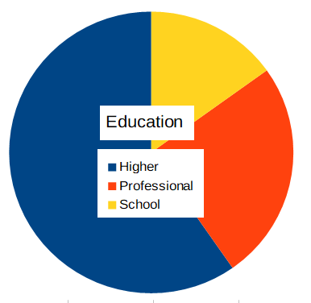
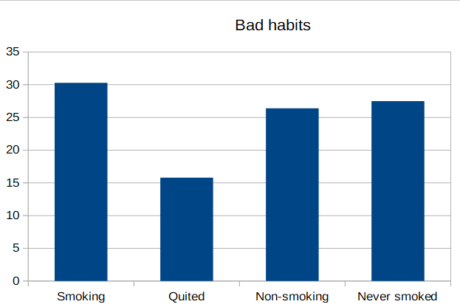
The picture of regular amateur user*
*Based on the survey according to the developed questionnaire held among the 241 visitors of fitness-centers in Kyiv in January 2020 who admitted buying muscles building supplements

Slide 13
Conclusion
Nutrition is an important part of many types of amateur sports training, the growing popularity of which has long become a global trend which has not bypassed Europe. According to the information and analytical platform FitnessConnectUA, today consumers of fitness services are more than 1 million people or 2.4% of the population of Europe. The annual turnover of the market of fitness services in Europe is about $ 201.8 million, and in the near future these figures will grow.
The majority of European market players (80%) are foreign companies.
Among supplements trends plant-based products show increasing demand.
The main groups for buying muscles building supplements are Athletes, Bodybuilders, Amateur Users, Recreational and Lifestyle Users, Extreme Activities Users.
The most perspective target group for introducing a new product is Amateur Users who now take the 18 % in general market structure, but constantly raising due to the involvement of the population in fitness activities.

Slide 14
